Slide 1
JF 4_1 Practice
Try It/Solve It:
Create a presentation to highlight five or more Views that may be of interest to a programmer using Eclipse. Use the help system to learn about the Views available in Eclipse. Work in teams of two to create and deliver the presentation. The presentation should include the following:
A presentation introduction defining the presentation purpose and the team members.
A list of five or more Views in Eclipse that will be highlighted.
The reason your team selected the five Views to demonstrate.
The process your team went through to choose the five Views.
The actual demonstration and description of the components.
The presentation summary

Slide 2
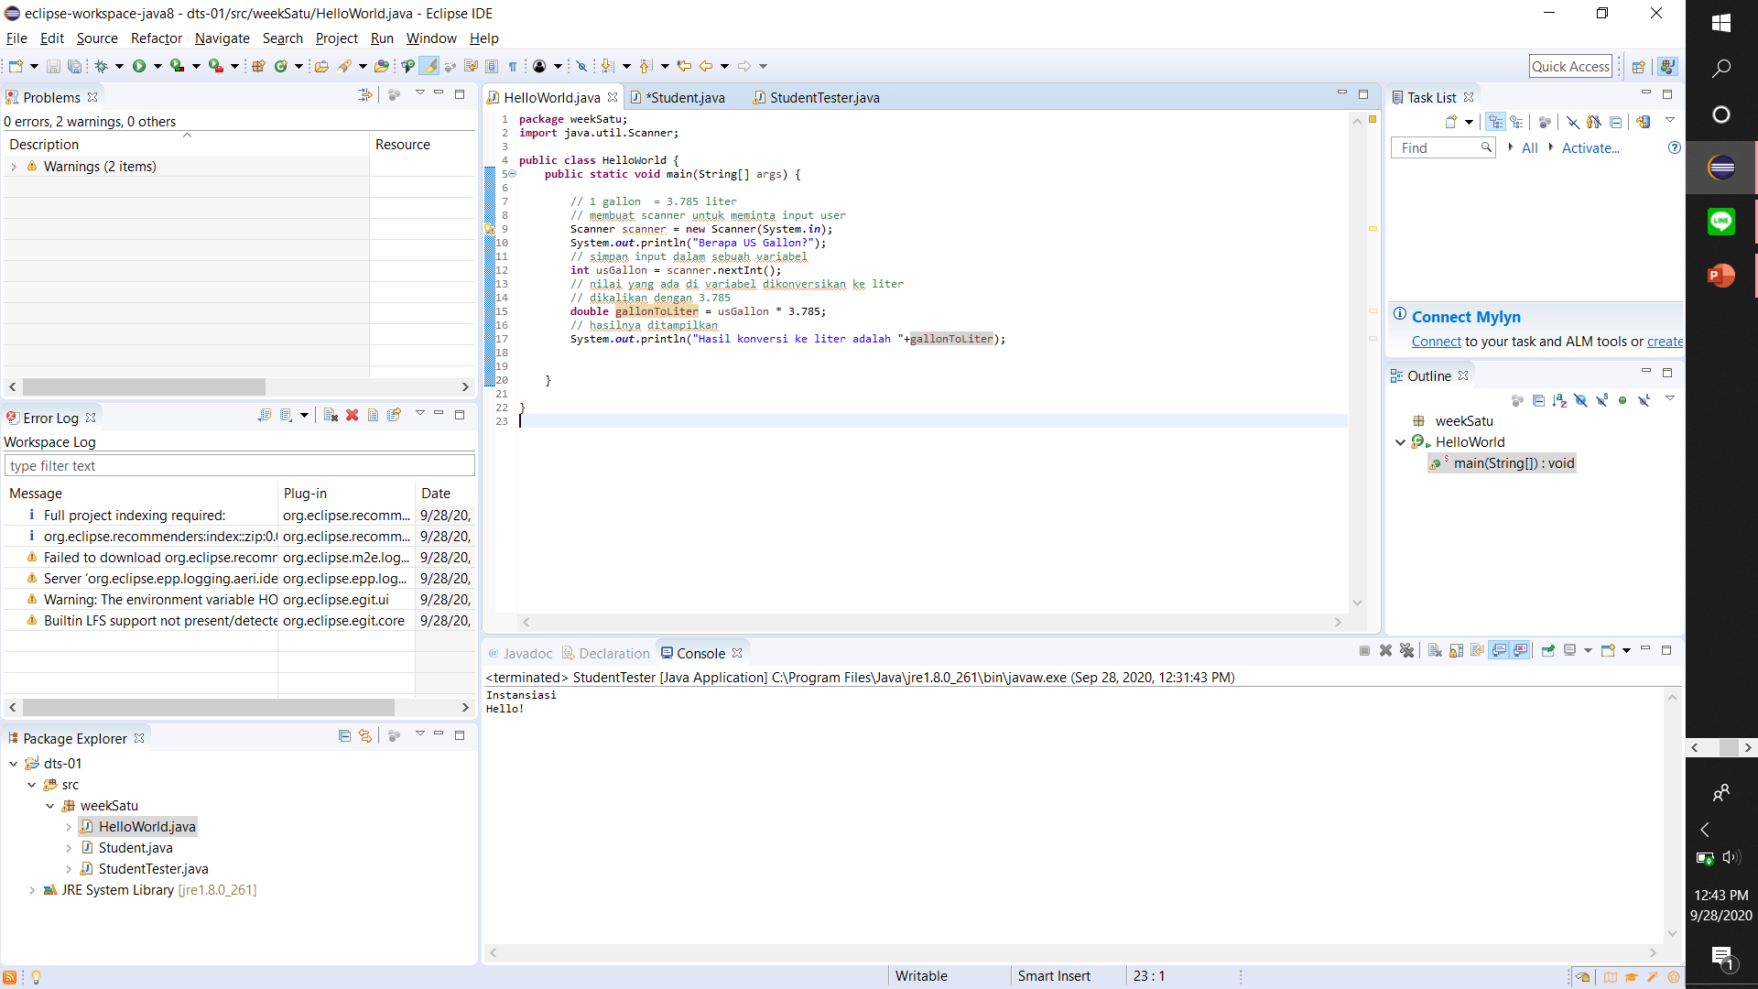
List of Eclipse Views
Problems
Outline
Error log
Package Explorer
Console

Slide 3
Problems
Error Log
Package Expl.
Displaying unresolved syntax written on the code
The Eclipse error log captures internal errors that are caused by the operating system or your code.
Showing the directory of java classes file within the hierarchy
Console
Outline
Showing the result of code running
Showing the currently running package and java classes file

